Slide 1
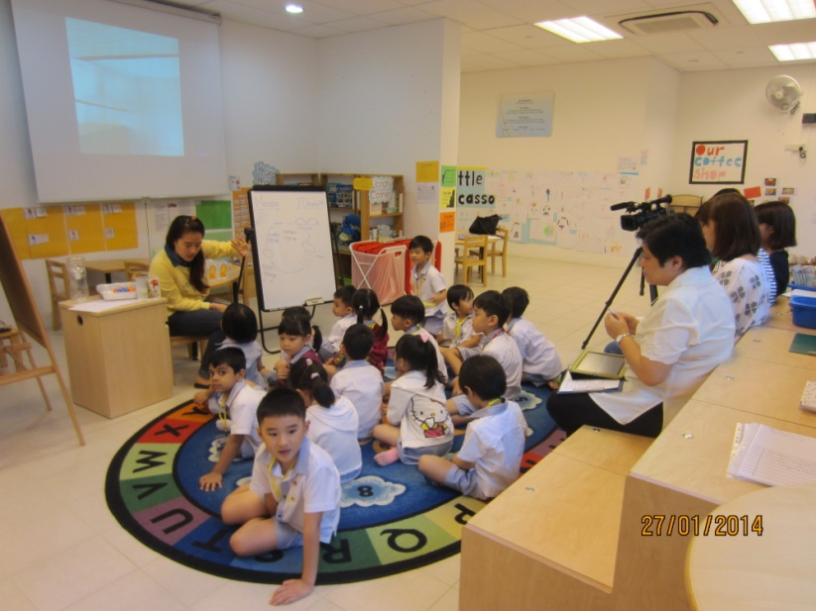
Lesson Study in Early Childhood Sector (Singapore)
Peggy Foo (Marshall Cavendish Institute)
Magdaline Kang (PAP Community Foundation)

Slide 2
Content
Landscape of early childhood education in Singapore
Lesson Study@ PCF Kindergarten (Tanjong Pagar - Tiong Bahru @ Pinnacle)

Slide 3
Early Childhood Landscape
Kindergartens Kindergartens provide a 4-year pre-school developmental programme for children from 2.5 to 6 years of age (consist of Nursery 1 & 2, Kindergarten 1&2.
Child Care Centres Child care centres provide child care services for children aged 18 months and 6 years old. Several centres also provide infant care programmes for infants aged between 2 to 18 months old.
Notes:
The Singapore pre-school landscape today comprises both kindergartens and child care centres.

Slide 4
Early Childhood Landscape
Early childhood education (below 7 years old) is not part of the formal education in Singapore
Quality of teaching and learning in preschools is uneven
A strong call from public to revamp the early childhood sector
The government stepped in to revamp and regulate the whole sector officially in 2013
Notes:
The Early Childhood and Development Agency (ECDA) will serve as the regulatory and developmental authority for the early childhood sector in Singapore, overseeing all aspects of children’s development below the age of 6, across both kindergartens and child care centres.

Slide 5
Early Childhood Development Agency (ECDA) 1 April 2013
Enhance the quality of teaching and learning
Develop a Continuing Professional Development (CPD) Framework for early childhood educators (in-service)

Slide 6
PAP Community Foundation (PCF)
Set up in the early 1960s to help prepare children for entry into primary schools
Provide affordable preschool education
In 1986, the People's Action Party set up its charitable arm, the PAP Community Foundation (PCF)
We have more than 300 kindergartens & childcare centres in heartlands of Singapore
Notes:
2010: 10 kindergartens
2011: 15 kindergartens
2012: 23 kindergartens
2013: 32 kindergartens

Slide 7
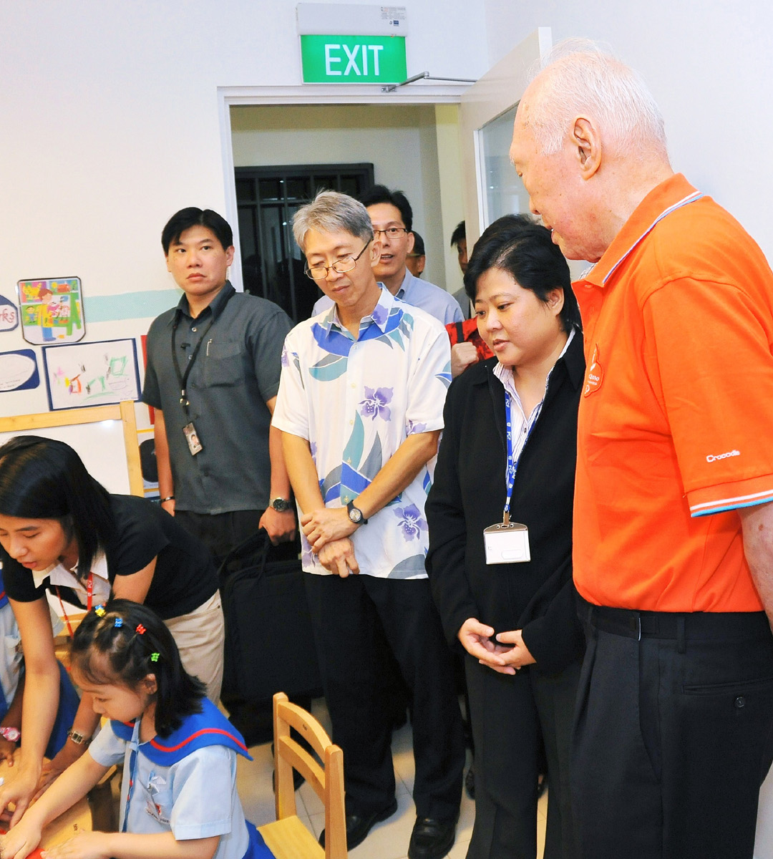
PAP Community Foundation
Tanjong Pagar – Tiong Bahru Education Centre @ Pinnacle
1 of the 5 centres who pioneered the project on Lesson Study in 2009
The only centre who sustains the practice since 2009
Lesson study was even showcased to our Ex-Minister Mentor Lee Kuan Yew at our opening ceremony (2010)

Slide 8
Profile of Teachers (2013)
6 teachers in the learning team
1 principal, 1 vice-principal, 4 teachers (mostly beginning teachers)
Joey Yuen
Valerie Tan
Lynn Yeo
Chan Su Xuan
Novice teacher
Selene Tung
Research teacher 2013
2 yrs
Mentoring teacher
Research teacher 2012
Research teacher 2011 & 2010)
Vice-Principal cum mentoring teacher
2 yrs
4 years
1 year
Novice teacher
1 year

Slide 9
Research Theme
How can we help all children learn by differentiating our teaching practices?

Slide 10
Lesson Study Cycle
Identify Research Theme
Plan Lesson
Lesson Plan Revision
Research Lesson
Post-Lesson Discussion

Slide 11
Theme: Rain and Floods
Lesson
Topic
Lesson 1
Lesson 2
Lesson 3
How rain is formed?
(environment aware focusing on water cycle)
How do we measure rainfall?
(numeracy lesson focusing on measurement)
How do we prepare for floods?
(literacy lesson using written words and
drawings)

Slide 12
Identify Research Theme
Plan Lesson
Lesson Plan Revision
Research Lesson
Post-Lesson Discussion

Slide 13
Lesson on Measuring Rainfall for a K2 Class
Lesson Segment | Integrated Lesson (with focus on Numeracy)
Tuning in activity | Recap on water cycle What could be used to measure rain water?
Development (Learning Tasks) | Use non-standard measuring unit (cubes) Engage in hands-on activity to measure rainfall Organise data in a pictograph
Consolidation/ Conclusion | Differentiate through the use of effective questioning based on the pictograph

Slide 14
Identify Research Theme
Plan Lesson
Lesson Plan Revision
Research Lesson
Post-Lesson Discussion

Slide 15
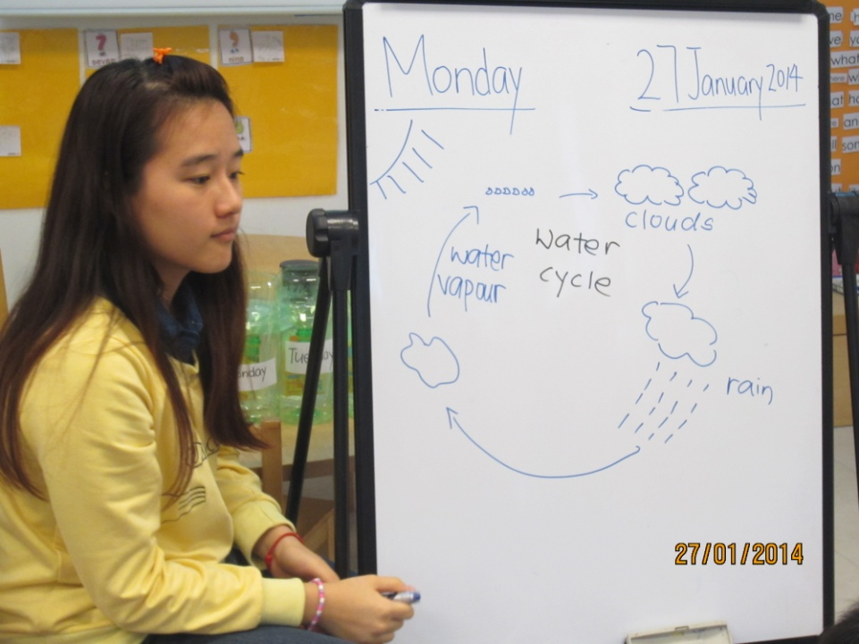
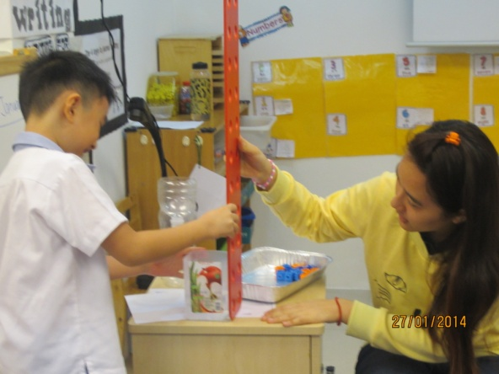
Tuning-in Activity
Recap water cycle
Brainstorm different non-standard measurements which could be used to measure the level of rainfall

Slide 16
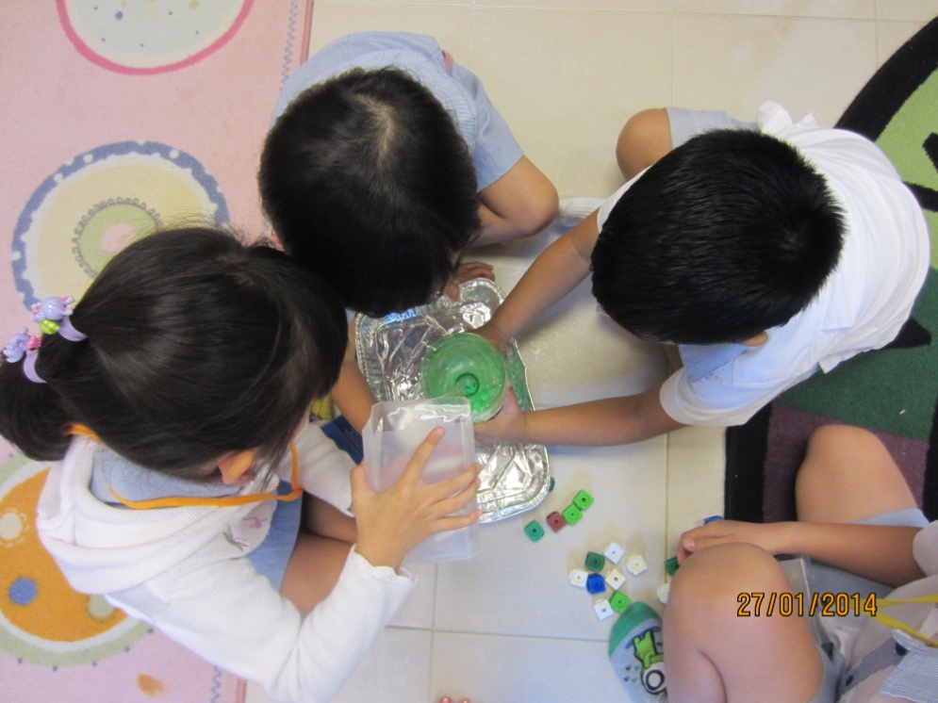
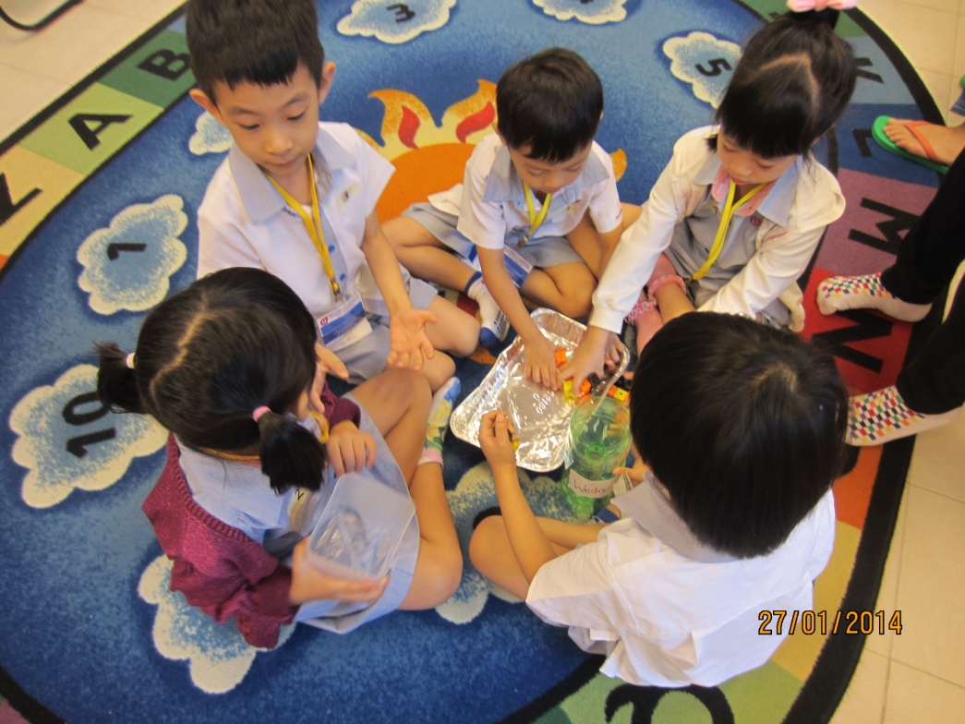
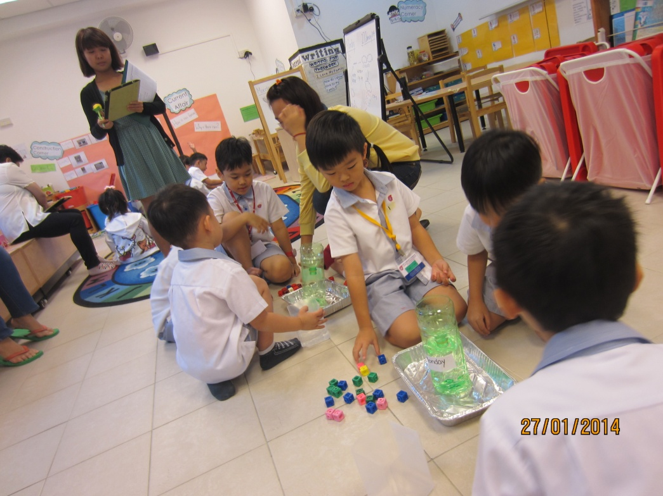
Measuring Rainfall using Non-Standard Unit

Slide 17
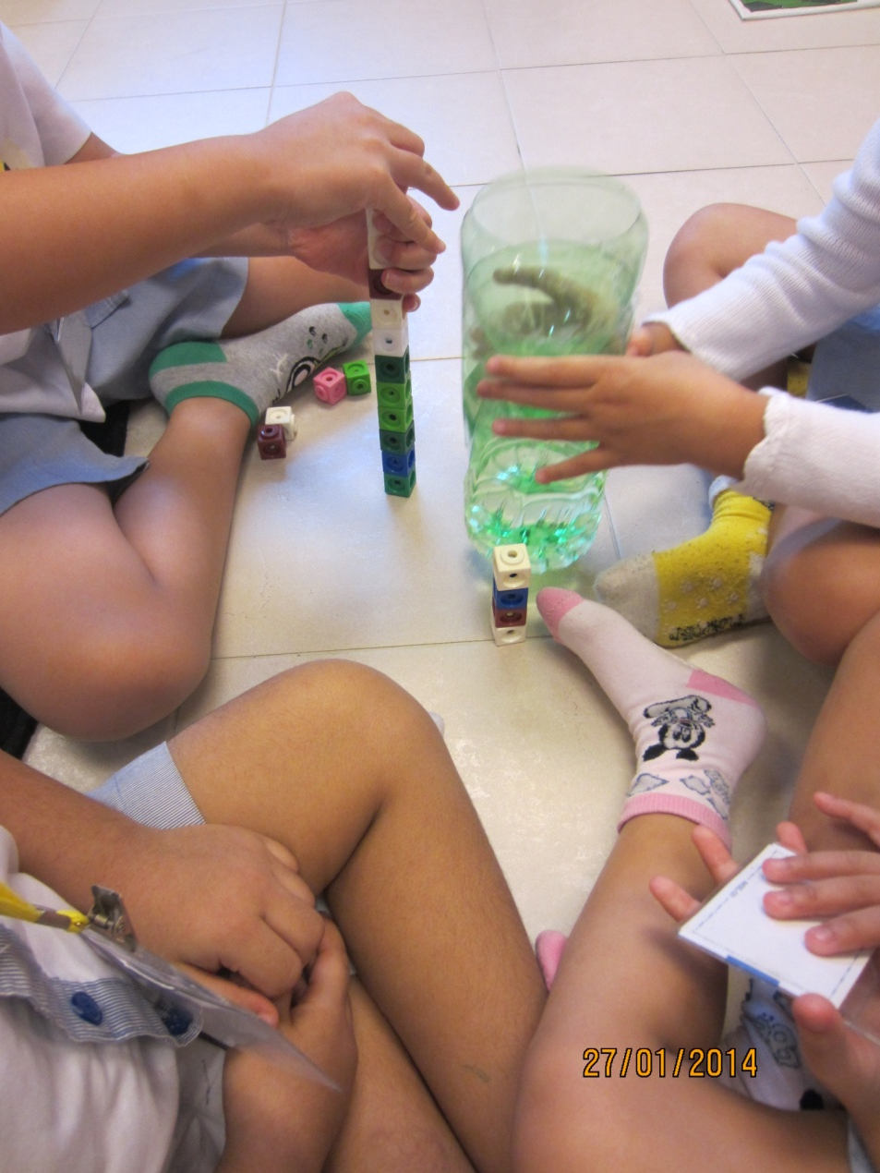
Watch a video clip (Creating a pictograph)

Slide 19
Professional Learning
Use of mathematical language
Use of questions to extend thinking

Slide 20
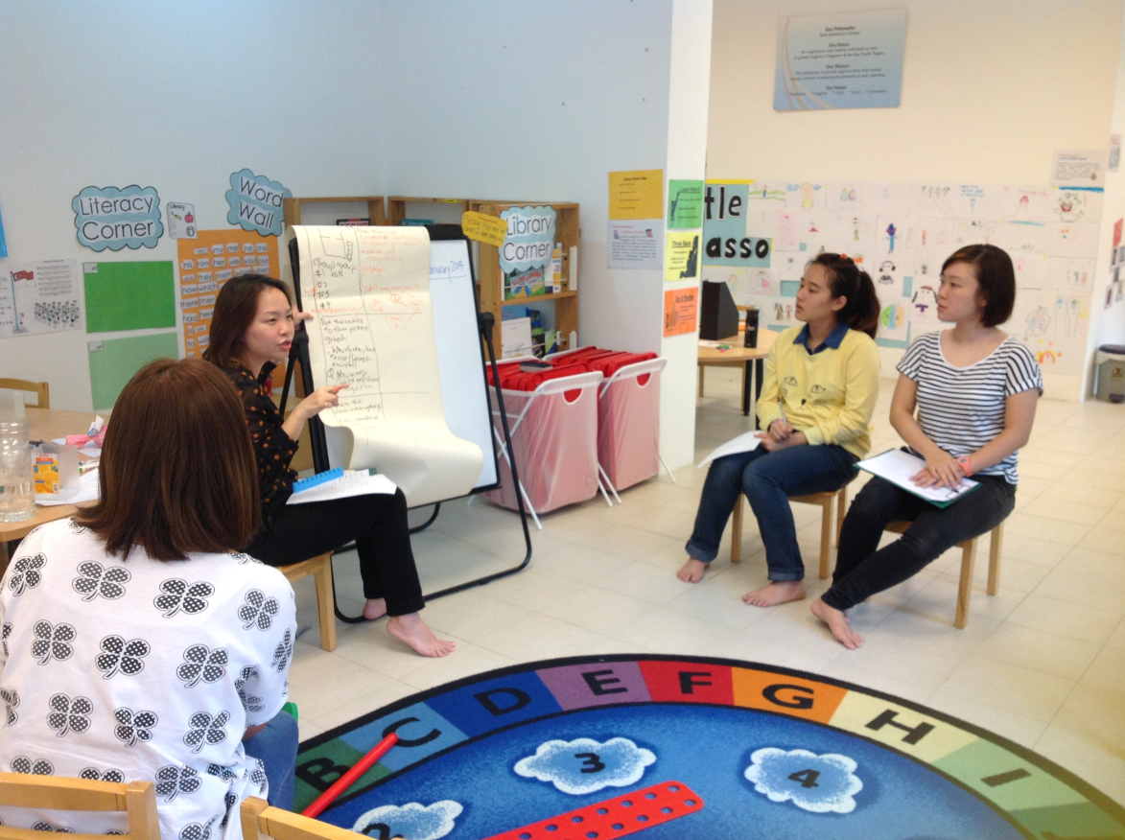
Use of Mathematical Language
Research Lesson
Comments and Recommendations
The water level is 5 cubes
The water level is as high as 5 cubes
Notes:
Language
More than/ less than (consistent language)
Children’s thinking and learning
Children are visual and take things literally (size vs quantity)
Way they count the counters
Differentiation (advanced learners and struggling learners)
Given 2 numbers and 2 blanks (open-ended)
Differentiation (One to one counting – arrangement of materials is impt)
Content
Content (chose of number less than 20), teach less than in another lesson

Slide 21
Use of Questions to Extend Thinking
Research Lesson
Comments and Recommendations
Which day has the most rainfall?
Which day has the least rainfall?
How many cubes are there altogether?
Do you think we can find the total amount of rainfall over the 4 days?
How can you find the total amount of rainfall?
Notes:
Language
More than/ less than (consistent language)
Children’s thinking and learning
Children are visual and take things literally (size vs quantity)
Way they count the counters
Differentiation (advanced learners and struggling learners)
Given 2 numbers and 2 blanks (open-ended)
Differentiation (One to one counting – arrangement of materials is impt)
Content
Content (chose of number less than 20), teach less than in another lesson

Slide 22
Use of Questions to Extend Thinking
Research Lesson
Comments and Recommendations
The children used one-to-one counting
(6 + 2 + 1 + 4)
Teacher could challenge advanced learners to think of another way of counting
One alternative method is making 10
Use of ten frames

Slide 23
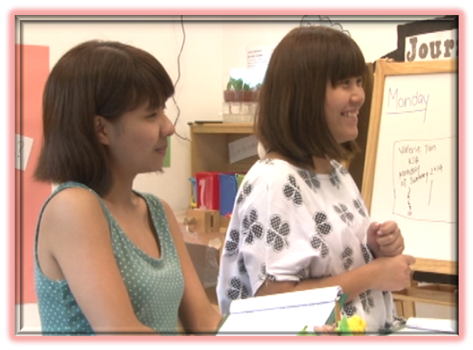
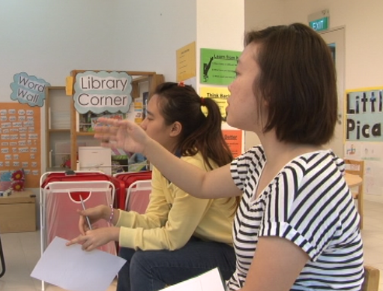
Reflection from Teachers
“Use more accurate terms (mathematical language)”
“Listen carefully to the children’s responses in order to extend their learning”
Notes:
Language
More than/ less than (consistent language)
Children’s thinking and learning
Children are visual and take things literally (size vs quantity)
Way they count the counters
Differentiation (advanced learners and struggling learners)
Given 2 numbers and 2 blanks (open-ended)
Differentiation (One to one counting – arrangement of materials is impt)
Content
Content (chose of number less than 20), teach less than in another lesson

Slide 24
Sharing with Fraternity and Beyond
Conducted open research lessons for educators from other centres
Presented at conferences (e.g. WALS, PECERA)
Publications of DVDs (i.e. Voices) and books (i.e. Teacher Research Through Lesson Study, and The Art of Reflection in Lesson Study, Vol. 1)

Slide 25
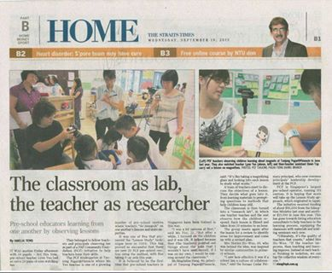
Featured in national newspaper, The Straits Times

Slide 26
Thank You!
peggyfoo@hotmail.com
magdalneheng@yahoo.co.uk

